Slide 1


Notes:
Welcome

Slide 2
Let’s Talk!
Why Metals?
Why ACM specifically?
Why choose to be an Affiliate?
The RIGHT time. The RIGHT products.
The RIGHT choice… The At Cost Metals Way!
Notes:
Why Metals?
Why ACM specifically?
Why choose to be an Affiliate?

Slide 3
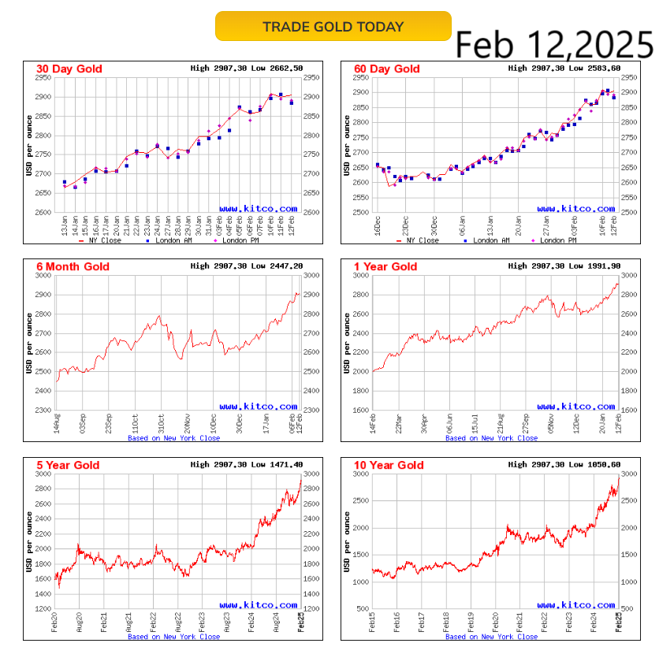
Why Metals?
Economic Strife...
Political Strife...
Inflation...
Privacy...
More resistant
to turbulence...
Take your pick.
This is what gold has done in the past. Past performance does
not indicate future earning... But it does leave clues
to learn from.

Slide 4
Why ACM?
ACM is a technology driven company interfacing with the largest market makers in precious metals bringing the best pricing possible to customers.
Compare the prices and see for yourself.

Slide 5
Why be an Affiliate?
This is simple. The advertising budget for ACM
could go to big tech or it can go to our Affiliates.
- The whole world is talking about Precious Metals.
- We choose our Affiliates.
The RIGHT time. The RIGHT products.
The RIGHT choice… The At Cost Metals Way!
Notes:
Align yourself with the wave of customers.

Slide 6
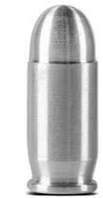
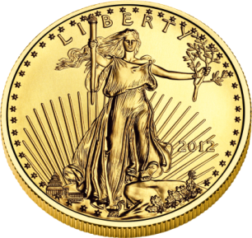
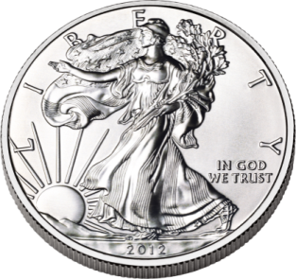
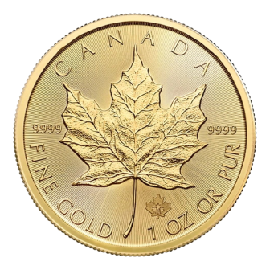
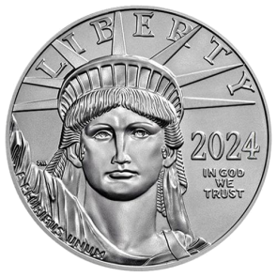
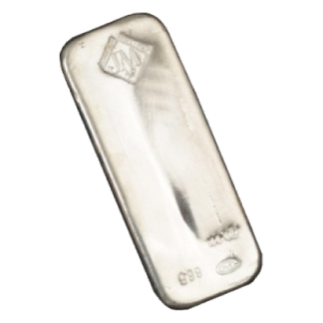
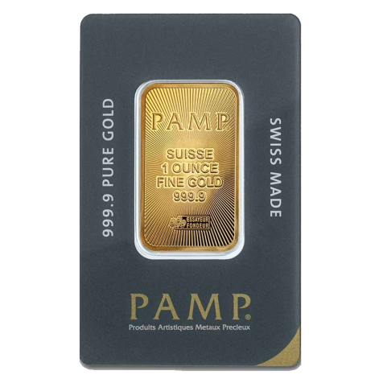
PRODUCTS
AT COST METALS
The Same Premium Metals—At Cost!
Top Coins: American Eagles, Buffalos, Morgan Peace Dollars, Maples, Krugerrands
Trusted Bars: Engelhard, Johnson Matthey, More
Explore 100+ Options Online!
Unmatched Quality, Unbeatable Prices!
Notes:
It’s the Same Stuff!!

Slide 7
AT COST
VS. DEALER DIRECT
Why Pay More? Dealer Direct ≠ Best Deal
Real-Time Price Comparison:
At Cost Metals Price: $35.46
Largest Competitor: $38.69–$37.75
Typically 6.8 - 23% Savings

Slide 8
If this makes sense to YOU, let’s talk about the
Rewards plan!

Slide 9
STELLAR
MEMBERSHIP OPTIONS
$299 Metals Plus Membership *
24 Months of UNLIMITED purchases
$179 Metals Membership *
1 year of UNLIMITED purchases
* Both Membership offer access to rare, specialty collectibles
Unlock exclusive access. Build your legacy.

Slide 10
POINTS
BREAKDOWN
$299 Metals PLUS Membership
$50 Direct Commissions
60 Reward Points
$179 METALS Membership
$50 Direct Commission
30 Reward Points
Your success starts with every
At Cost Metals Membership

Slide 11
Qualification
for Direct Commissions
L
R
Direct Commission for All Affiliate Ranks
Requirements: Just be the Affiliate to make the introduction / sale of an ACM Membership.

Slide 12
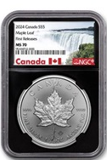
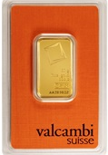
SPECIALTY
OFFERINGS
GET-A-HEAD Monthly Program
Perfect MS70/PR70 numismatic coins or specialty bullion shipped monthly
Additional Heads Up Coins
Available in your shopping cart for added variety
Specialty Bullion
Unique coins & bars from around the world
Priced BELOW typical retail for collectors
Expand your collection. Broaden your wealth.
Notes:
Plenty of options to choose from.

Slide 13
PRODUCT
POINTS AND OPPORTUNITIES
GET-A-HEAD Monthly Coin & Specialty Bullion
10–35 Reward Points
Direct Commission
At Cost Bullion
Direct Commission – significant yet appropriate
Every REAL MONEY coin counts
toward building your future.
Notes:
Let’s dive into Product Points and Opportunities with At Cost Metals.
First up, the Get-A-Head Monthly Coin. Depending on the coin you select, these could carry 15 to 35 binary points. These points accumulate toward your overall total, keeping you active in the system and pushing you closer to earning commissions.
Next, we have Specialty Bullion. This includes unique coins and bars from around the world and carries anywhere from 1 to 50 binary points. Specialty bullion provides not only points but also the opportunity for direct commissions when your enrolled members purchase these items.
Here’s the exciting part: we’ve seen situations where a single purchase of specialty bullion has generated over 4,000 binary points! This happens because our members are choosing real money—precious metals—over inflated, fake money. The higher-value items, like specialty bullion, can really make a difference in how your points accumulate and how you grow your business.
By sharing your experience and helping others purchase precious metals, you can earn direct commissions when they purchase specialty bullion. Every coin or piece of specialty bullion you buy counts toward building your wealth and your future, while you get rewarded for guiding them to the right choice.

Slide 14
BINARY
TEAM CYCLES
Promo Reward Points
400/400 Reward Points = $400 Cycle Bonus
Matching Bonus
10% Match on Personal Referral’s Cycles
Available to Affiliates ranked Silver or Gold
Earn as your team grows.
Notes:
Now, let’s break down how the Binary Team Cycles work and how they can pay off big for you.
The Binary Structure is based on the accumulation of points, which come from membership sales, specialty coin purchases, and our Get-A-Head Coin of the Month program. Here’s the key: 500 points on the left team and 500 points on the right team equals a $500 cycle bonus. Every time you hit that 500/500 threshold, you earn that bonus. It’s that simple.
And here’s the best part: all of this is tracked in real time on the website you’re given for free. You can log into your back office anytime to check your progress, see your accumulated points, and watch as you earn.
Now, there’s also a Matching Bonus built into the structure. You earn a 10% match on the cycle bonuses of the people you personally refer. This is available to you once you reach the Silver Affiliate or Gold Affiliate ranks. Here’s an example: if someone you’ve enrolled hits a $500 cycle, you earn 10% of that, which is $50. Imagine getting multiple $50 payouts as your personal referral’s cycle!
But here’s the interesting part: the beauty of this system is that it provides a level playing field. Even if you’re just starting, someone below you can out-earn you if they’re making sales and accumulating points faster. The key is that, as a Silver or Gold affiliate, you’ll be positioned to earn that 10% matching bonus on the cycles of your personal referrals.
So, there might come a time when you see $50 commissions coming in from your personally sponsored who are earning their $500 cycle bonuses, even though you haven’t reached your own $500 cycle that week. This structure lets everyone have the same opportunity—it’s about working together and helping each other succeed.
This compensation plan isn’t just fair—it’s a true opportunity for anyone to rise, earn, and create success, no matter where they start. And it’s really powerful to know you can get rewarded by helping others achieve their goals and cycle too.

Slide 15
FAST START
INCENTIVE
300-300 = $300 CYCLE Bonus!
EARN $300 with 300 points on your left and 300 points on your right during your first cycle commission.
This one-time FAST START bonus is available within the first 14 days of enrollment
on the very first cycle!
Kickstart your earnings with a powerful first cycle!
Notes:
We have an exciting Fast Start Incentive designed to help you hit the ground running. If you’re new to the program, here’s how it works: you need to accumulate 300 points on your left side and 300 points on your right side. Once you do that, you’ll earn your first cycle bonus of $300.
This special offer is available within the first 14 days of your enrollment, giving you a great opportunity to jump-start your earnings. Instead of the usual 500/500 requirement, the threshold is reduced to 300/300 during this time, making it easier for you to start earning right away. Hit this target within your first two weeks, and you’ll receive $300 as your first cycle bonus—setting you up for success right from the start!

Slide 16
RANKS
& LEADERSHIP
COPPER Affiliate
Requirements:
  1 Personally Sponsored, ACTIVE Customer
  on both sides (Left/Right)
Earning Potential:
  Up to $2,000 per week
Build your foundation, grow your income.

Slide 17
RANKS
& LEADERSHIP
SILVER Affiliate
Requirements:
  3 Personally Sponsored, ACTIVE Customers
  on both sides (Left/Right)
  At least 1 Personally Sponsored COPPER-ranked customer on each side
Earning Potential:
  Up to $10,000 per week
Achieve Silver Affiliate: Where leadership
starts and At Cost Metals earnings soar!

Slide 18
RANKS
& LEADERSHIP
GOLD Affiliate
Requirements:
  6 Personally Sponsored, ACTIVE Customers
  on both sides (Left/Right)
  At least 1 Personally Sponsored SILVER-ranked customer on each side
Earning Potential:
  Up to $30,000 per week
Lead the way to limitless potential.

Slide 19
RANKS
& LEADERSHIP
All Affiliate Ranks
Requirements: Do something to generate at least 15 points in a rolling 32 days time frame.
Its all shared reward point volume, so if you want to recieve the points we ask that you help contribute to the points.
Lead the way to limitless potential.

Slide 20
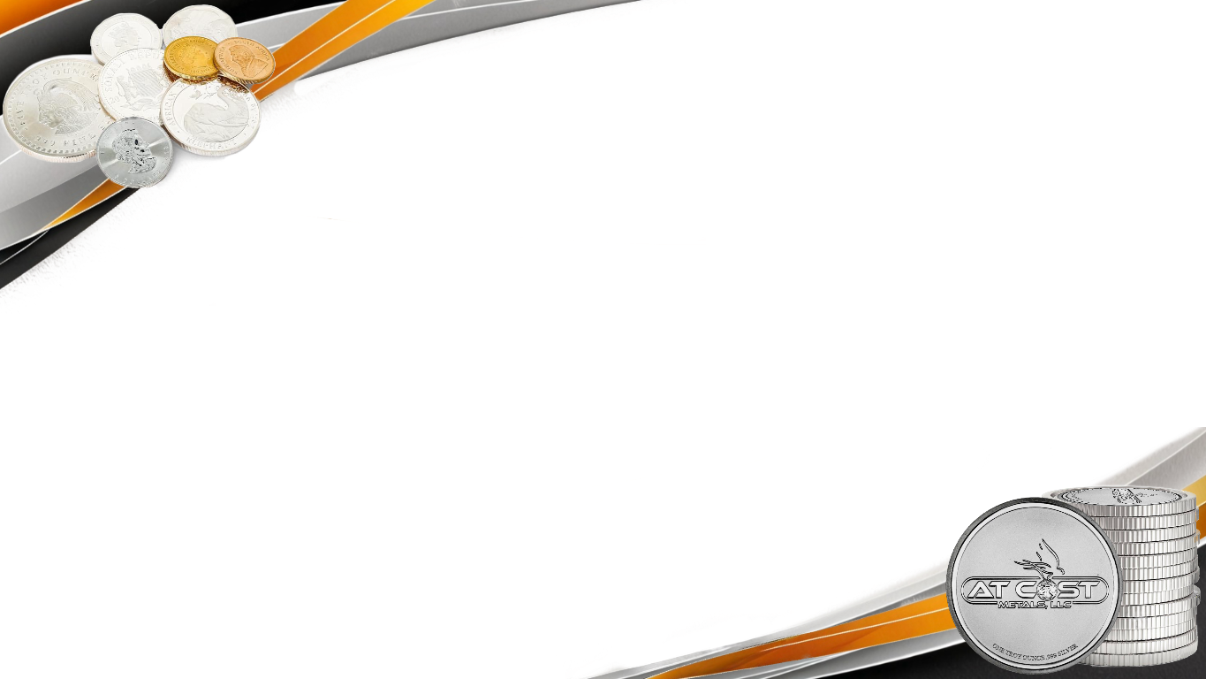
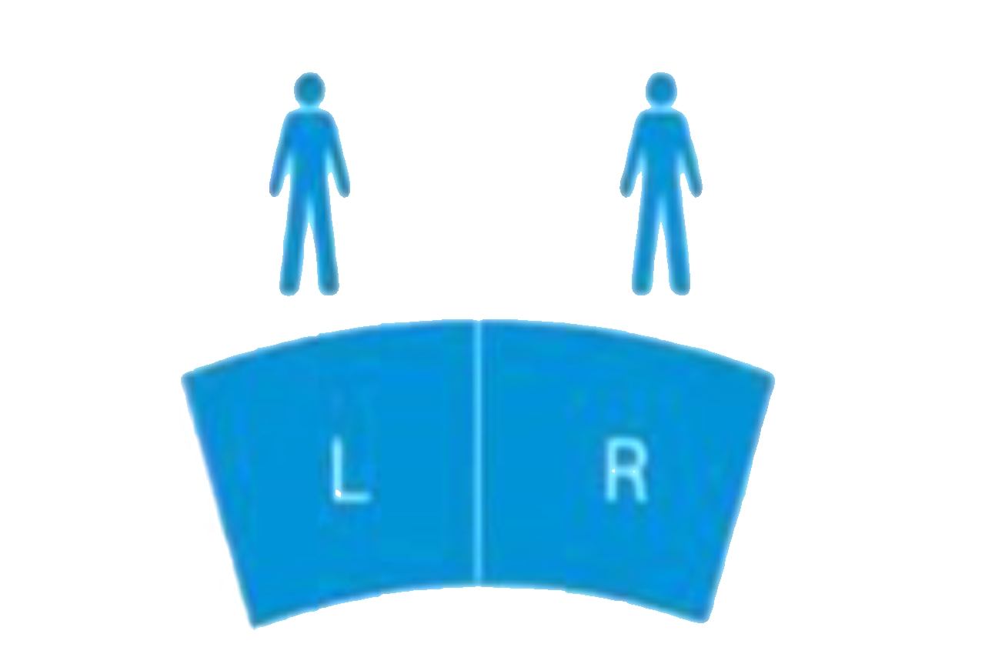

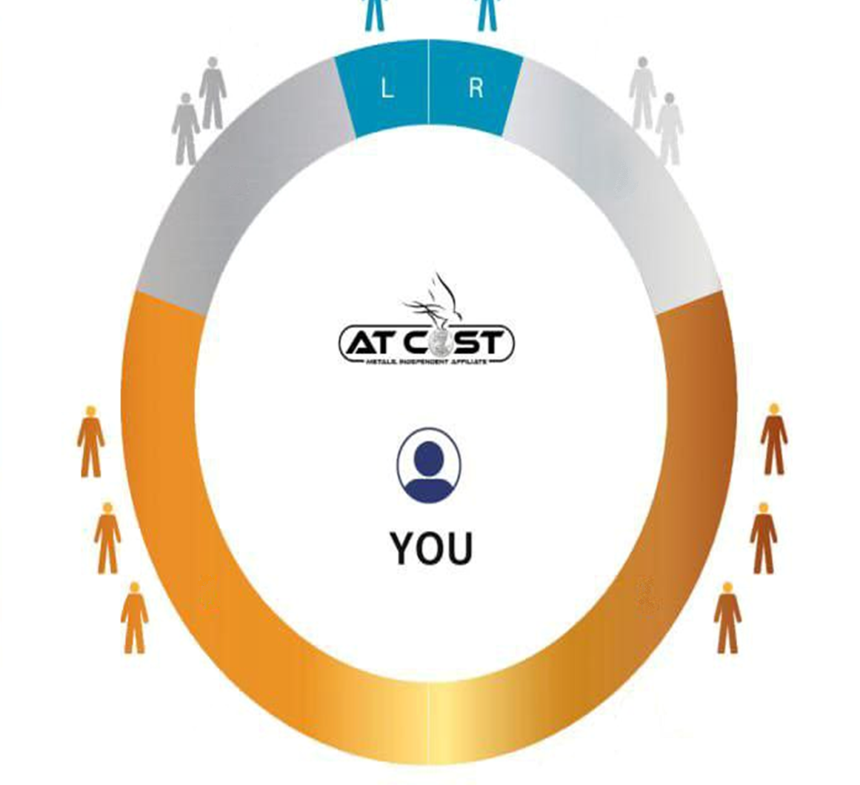


Qualification
for Team Commissions
COPPER AFFILIATE
1 ACTIVE CUSTOMER LEFT AND RIGHT
L
R
SILVER AFFILIATE
3 ACTIVE CUSTOMERS LEFT AND RIGHT
1 PERSONALLY SPONSORED, ACTIVE, COPPER
AFFILIATE ON BOTH SIDES (LEFT & RIGHT)
GOLD AFFILIATE
6 ACTIVE CUSTOMERS LEFT AND RIGHT
1 PERSONALLY SPONSORED, ACTIVE, Silver
AFFILIATE ON BOTH SIDES (LEFT & RIGHT)
To advance to the next rank,
it is necessary to help
those on your team
also to advance
Notes:
Visual recap to make it make sense.

Slide 21
AFFILIATE
ADDITIONAL INFORMATION
Points Accumulation:
Based on rank: 2k (Copper), 10k (Silver), 30k (Gold)
Unused points never reset after a cycle *
Commission Cycle:
Weekly pay period: Sunday 12am–Saturday 11:59pm Central Time
Sustainability:
75% commission cap ensures long-term stability.
Affiliate Influence
Leaders shape the company’s future.
* With an active Get-A-Head subscription, or enrolling 1 new customer every 32 days
Clarity, integrity and opportunities that last

Slide 22
INCOME/INVESTMENT DISCLOSURE
There are no guarantees regarding income in the At Cost Metals Rewards Program opportunity. The success or failure of each Affiliate, as in any other business, depends upon each Affiliate's skills and personal effort. Earning levels for an At Cost Metals Affiliate that appear are just examples and should not be construed as typical or average. Income level achievements are dependent upon the individual Affiliate's business skills, personal ambition, time, commitment, activity, and demographic factors.
The services offered by At Cost Metals, LLC may not be suitable for all consumers. You should seek financial / investment advice from your own independent financial advisor about your specific goals and situation. The value of precious metals changes constantly going up and down. There is potential risk in the purchase of precious metals. Nothing on our site or any marketing by an At Cost Metals Affiliate should be considered investment advice to you specifically.
Any purchases (including memberships, at cost bullion, graded
bullion or specialty bullion) should only be made after
consulting with your own financial advisor.
Transparency first and foremost: Your success is
in your hands, guided by your choices
Notes:
It’s an important disclaimer. Don’t skip this.

Slide 23
IT’S YOUR
TIME TO SHINE
The Bottom Line!
The smartest way to participate in precious metals
Unbeatable prices on bullion and rewards
Join us and start your journey today!
Let’s make it happen!
Seize the opportunity—your path to
precious metals success starts here!

Slide 24
Notes:
Thank you, thank you Thank you.

